Slide 1
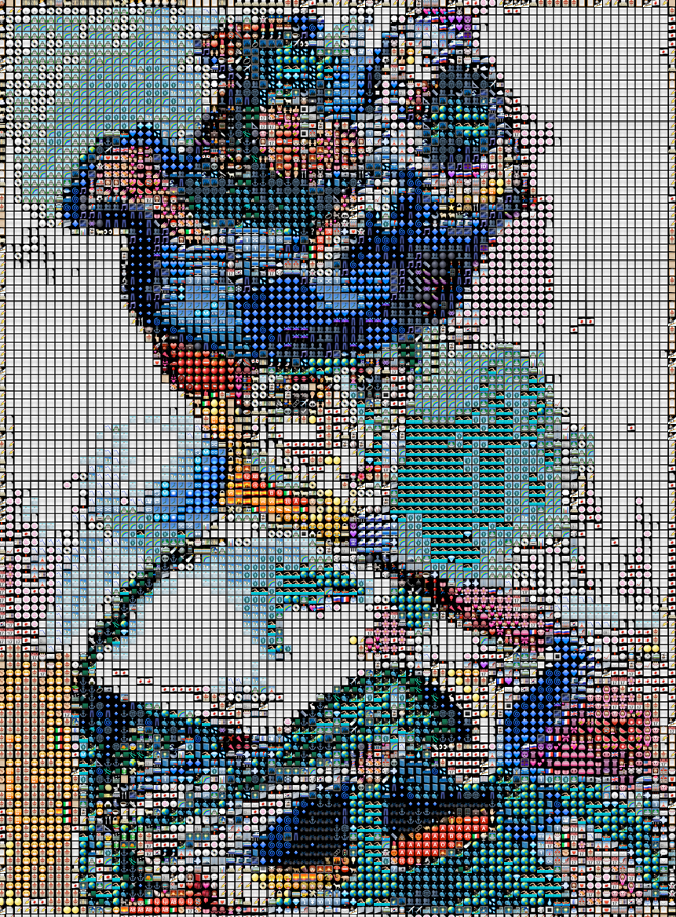
Emoji mosaic effect
on the selfie background
Chaeun Hong (hong.930), Yuting Yang (yang.5493)
For the project, we used edge detection, background subtraction, template matching, simple Euclidean distance, histogram comparison, and referred covariance matrix algorithms. Through techniques learned, we extracted the background from users’ selfies. Then, a emoji mosaic effect will be applied on the photo’s background. Our design enables users to experience digital cyber world using a simple artistic filter!

Slide 2

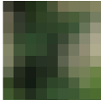


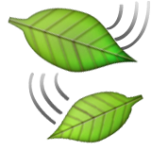
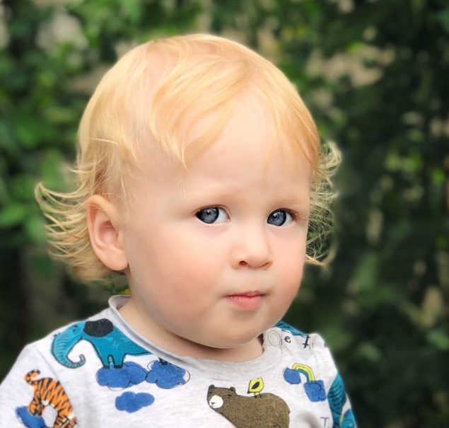
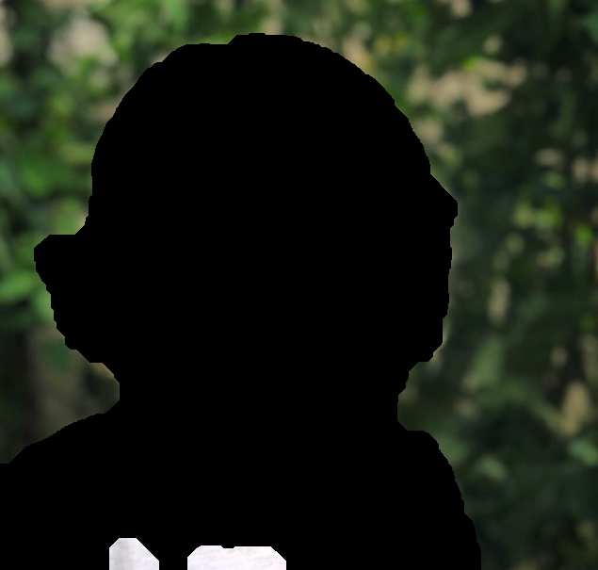
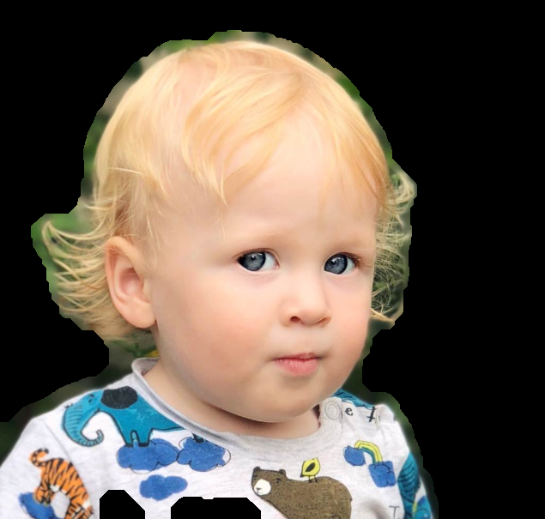
Framework
Data
Googling “iphone portrait image”, “selfie”
https://github.com/ericandrewlewis/emoji-mosaic
Algorithms/methods explored
Edge detection - Gaussian, Sobel, Canny, Laplacian of Gaussian
Binary image morphology - Dilation, Erosion
Mosaic - NCC, SAD, SSD, Euclidean distance, Covariance tracking (modified), Bhattacharyya coefficient (for evaluating color histogram similarity).
What we did
Chaeun - Image segmentation (foreground / background)
Lower brightness as a preprocessing -> edge detection with LoG -> Dilation edges & fill inside of edges & erosion -> separate foreground & background
Yuting - Image mosaic (background)
Image segmentation (Pixelization) -> find best match emoji mosaic for each segmentation, testing different algorithms -> recombine foreground and background

Slide 3
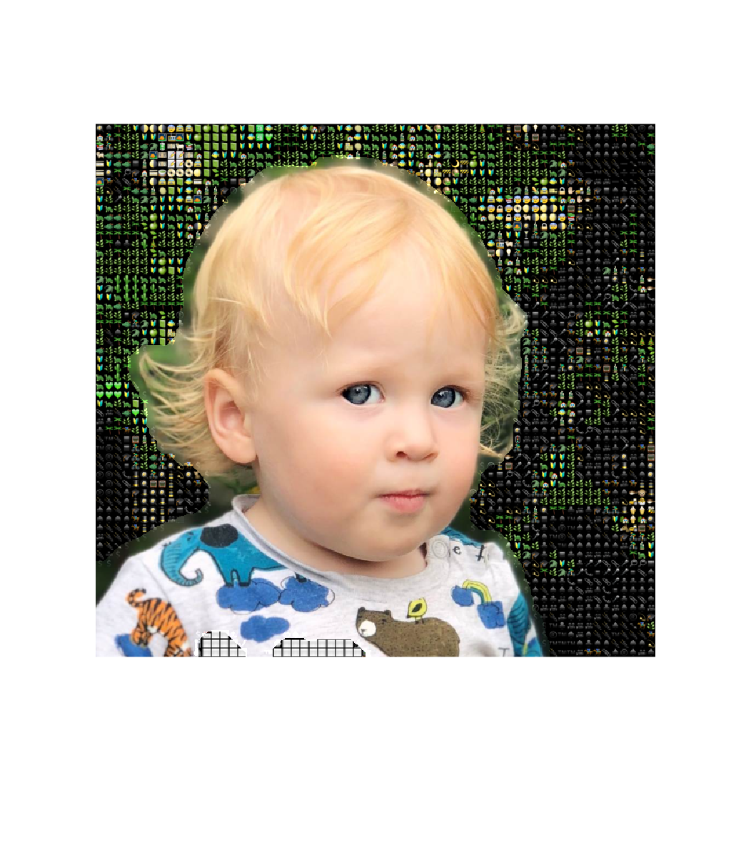
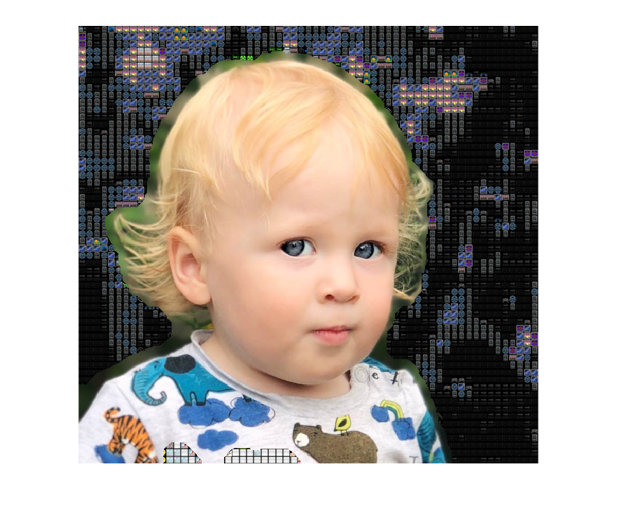
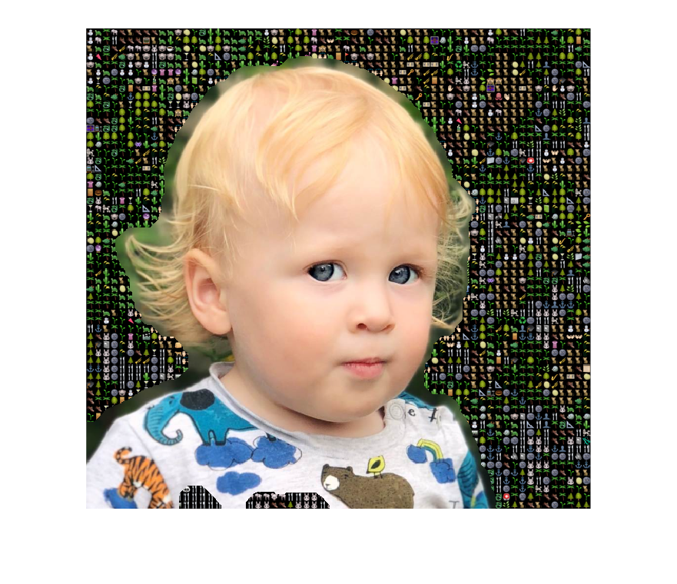
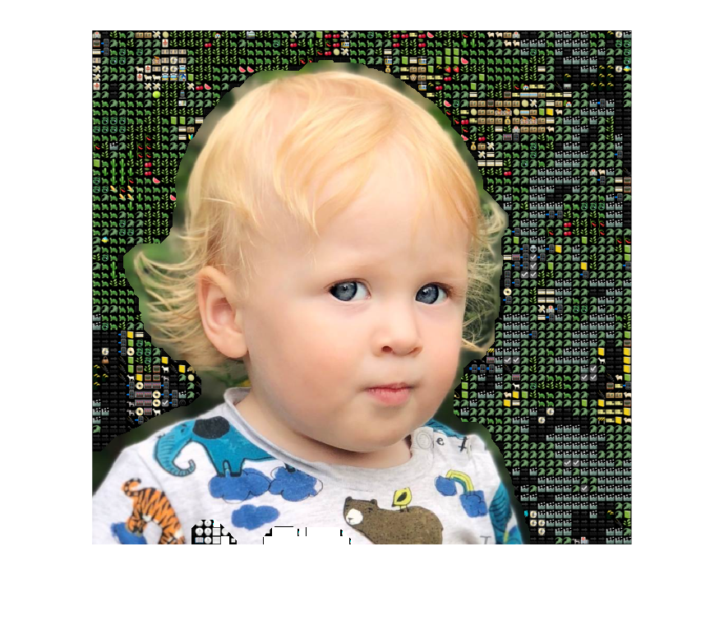

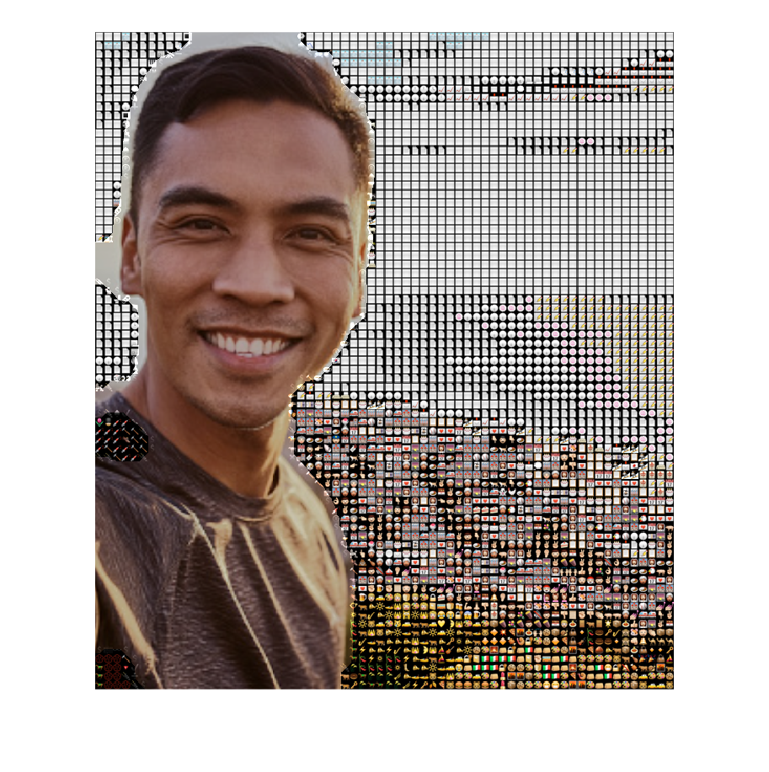
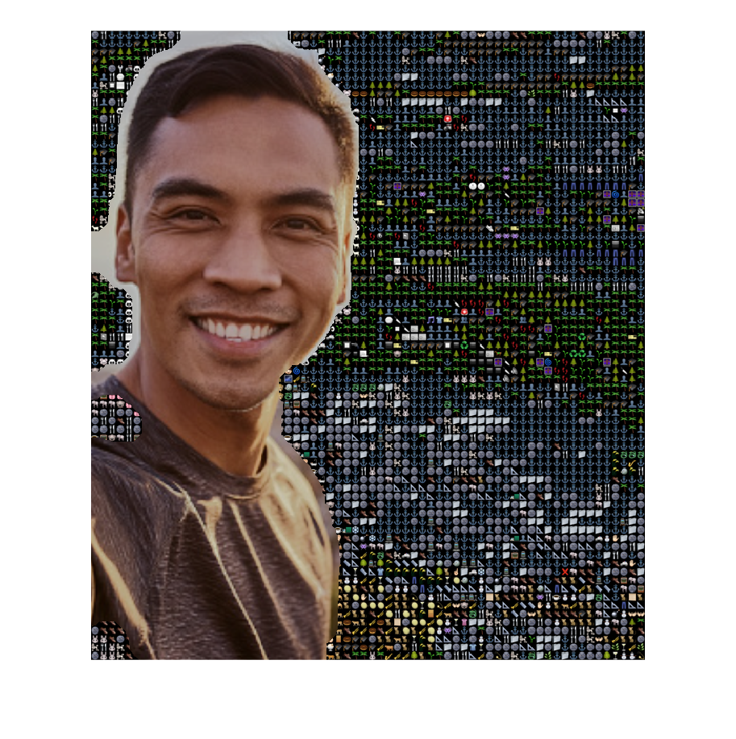
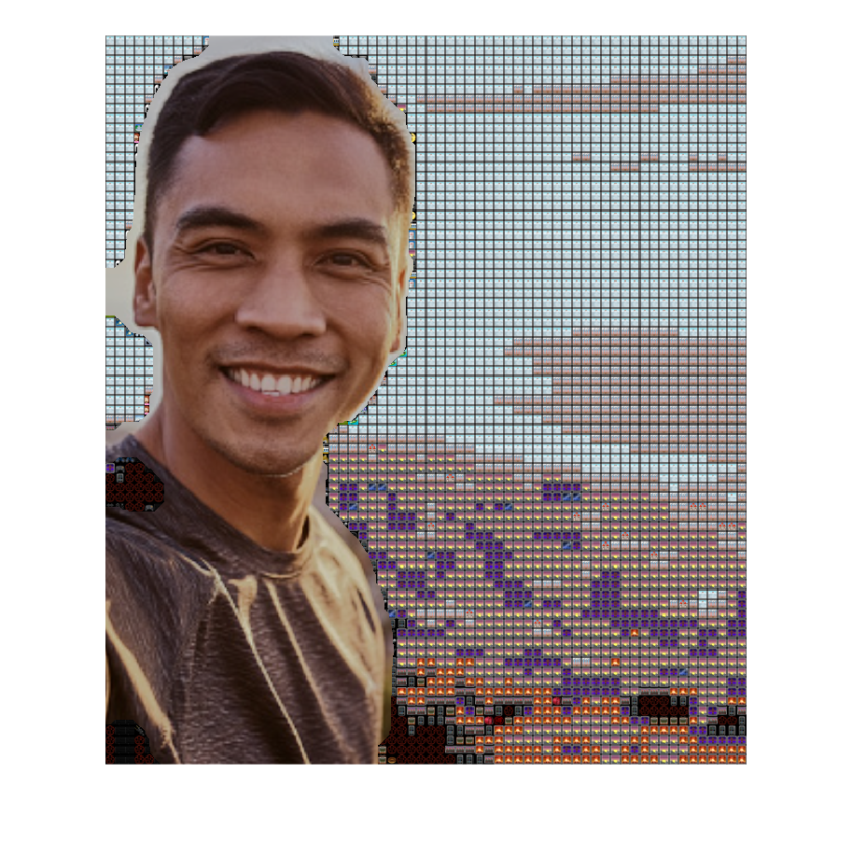
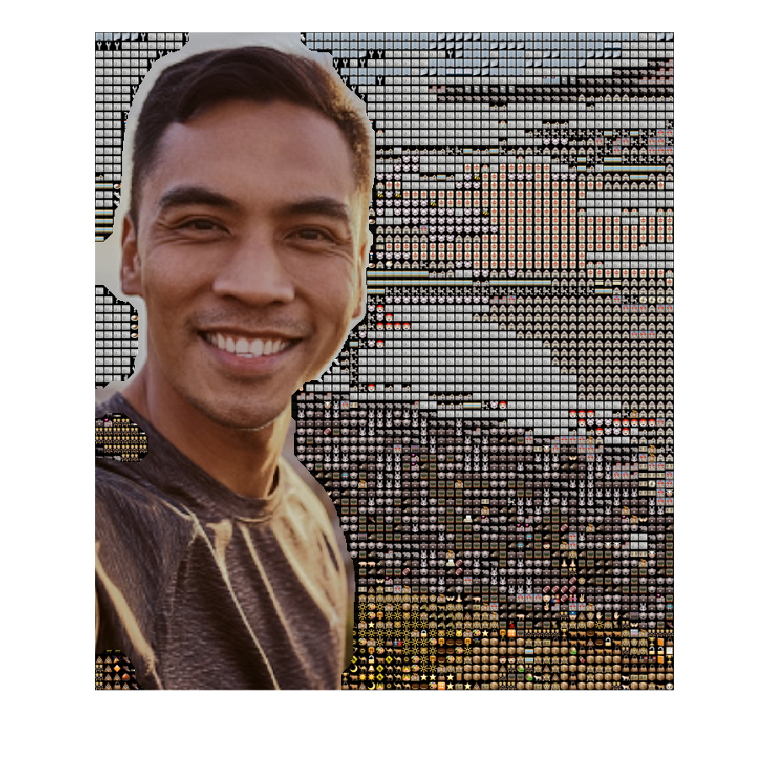
Result
Evaluate the results
Foreground/background segmentation
Laplacian of Gaussian filter shows the best
compared to the ground truth, accuracy at least 85%
Euclidean distance between RGBs works the best
Problems encountered
Limited images are working for segmentation - e.g., Does not work well when the background has bright part
Template matching techniques for mosaic did not work as good as expected
Influence of emojis’ background on color analysis
Lessons learned
Difference between each mask in edge detection
How the sigma values affect the result of edge detection
Only color information matters in generating mosaic
Clustering pixels greatly saves running time (inspired by Superpixels)
What else could be done (if you had more time)?
Revise code for better accuracy in the foreground/background separation
e.g., Preprocessing the image to reduce brightness background only
Apply this to the video instead of image
Original
Segmentation +
Euclidean distance
Modified covariance tracking
SSD
Bhattacharyya Coefficient

